Slide 2

Single Image Haze Removal Using Dark Channel Prior
COURSE: | ET4591
SUPERVISOR: | Assoc.Prof. Thi-Lan Le Assoc.Prof. Thanh-Hai Tran
Le Hong Anh | 20224300
Bui Minh Ngoc | 20224328

Slide 3
Table of contents:
I. Introduction
1. Problem Statement
2. Input/Output
3. Challenges
II. Proposed Method
1. Data Structure
2. Algorithm
3. Experiment
III. Conclusion

Slide 4
Introduction

Slide 5
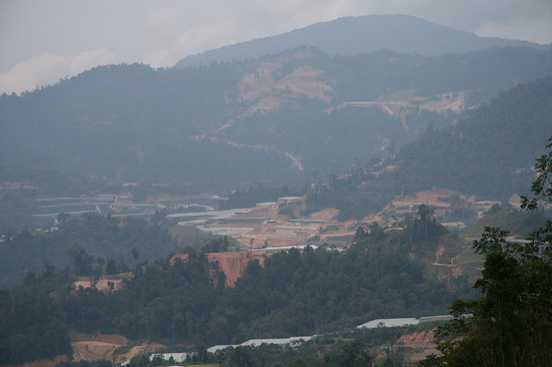
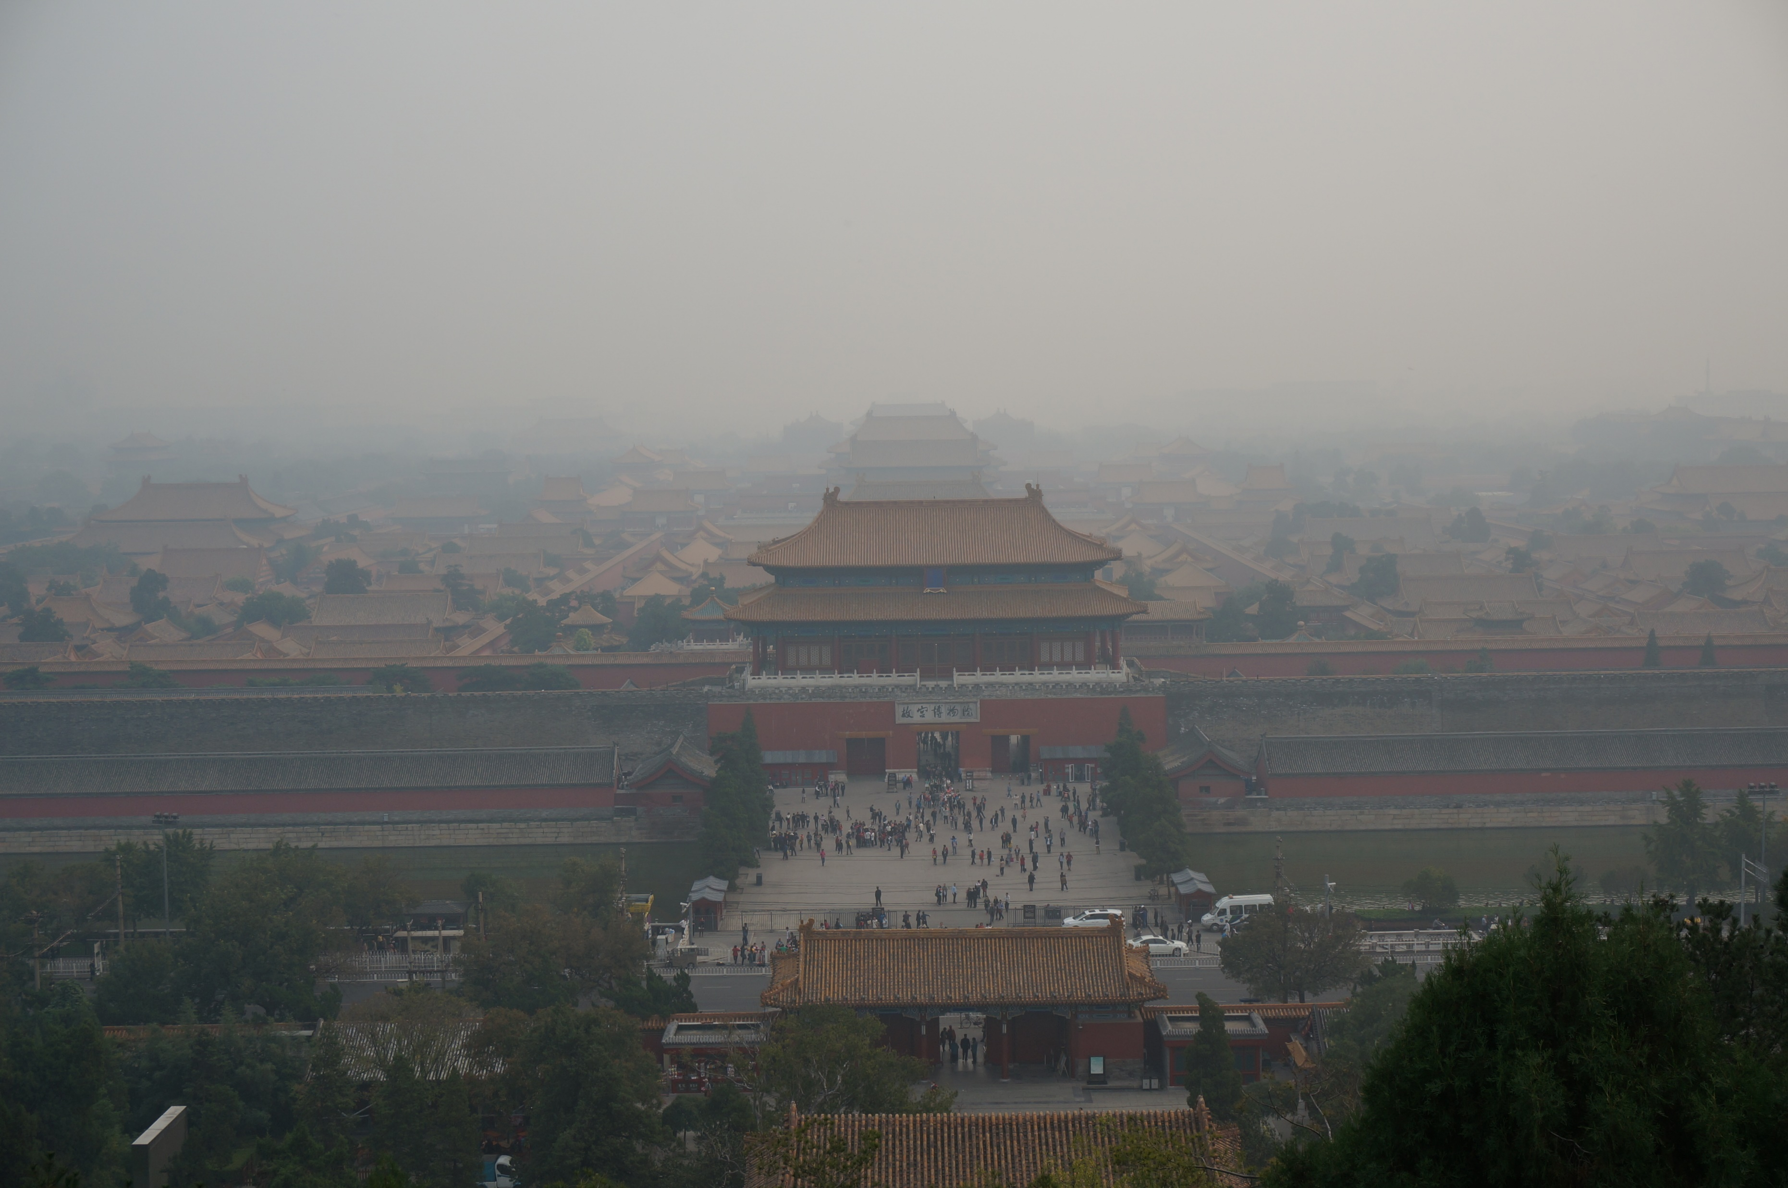
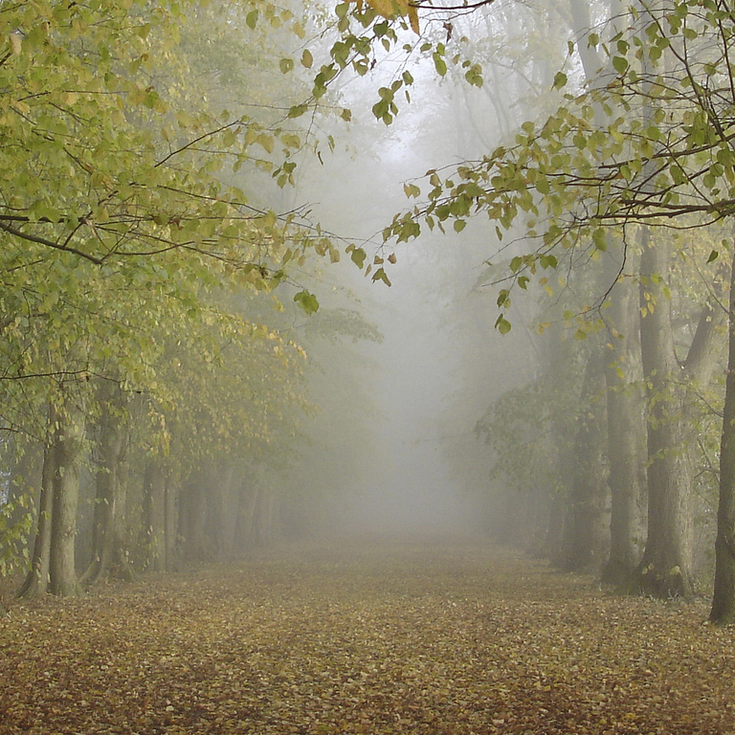
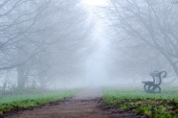
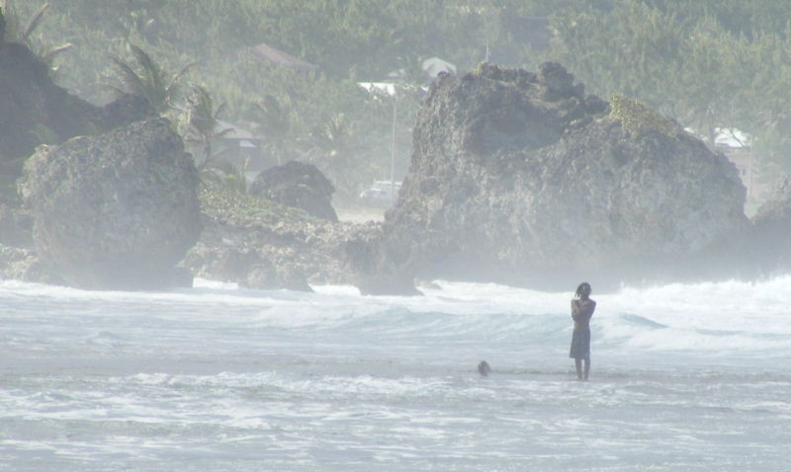
1. Problem Statement
Reccent issue:
Due to the prevalent poor atmospheric conditions in many regions today, outdoor images often suffer significant degradation, leading to a reduction in visibility and making the analysis and interpretation of visual data increasingly challenging.
Such conditions, including haze, fog, and pollution, obscure critical details in images, which can be detrimental in various applications, such as surveillance, autonomous navigation, and environmental monitoring.

Slide 6
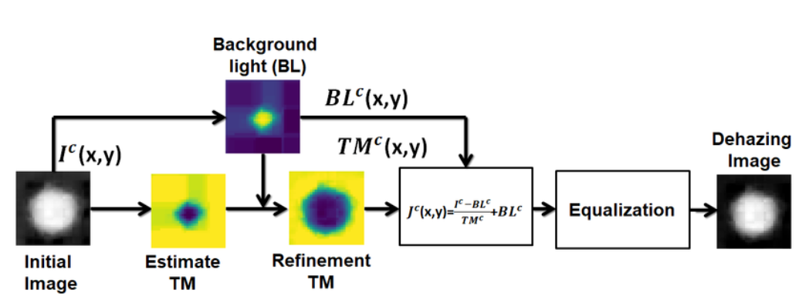
1. Problem Statement
The Dark Channel Prior (DCP) method was used to effectively dehaze these images, restoring their clarity and enhancing their usability for accurate analysis and decision-making.

Slide 7
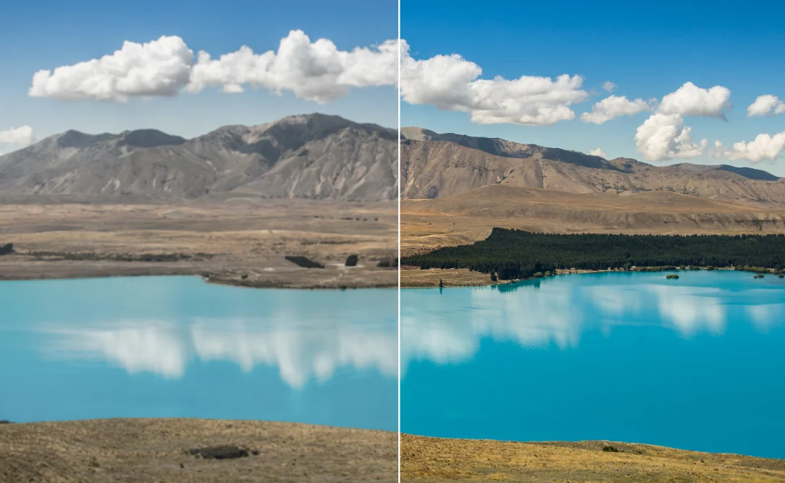
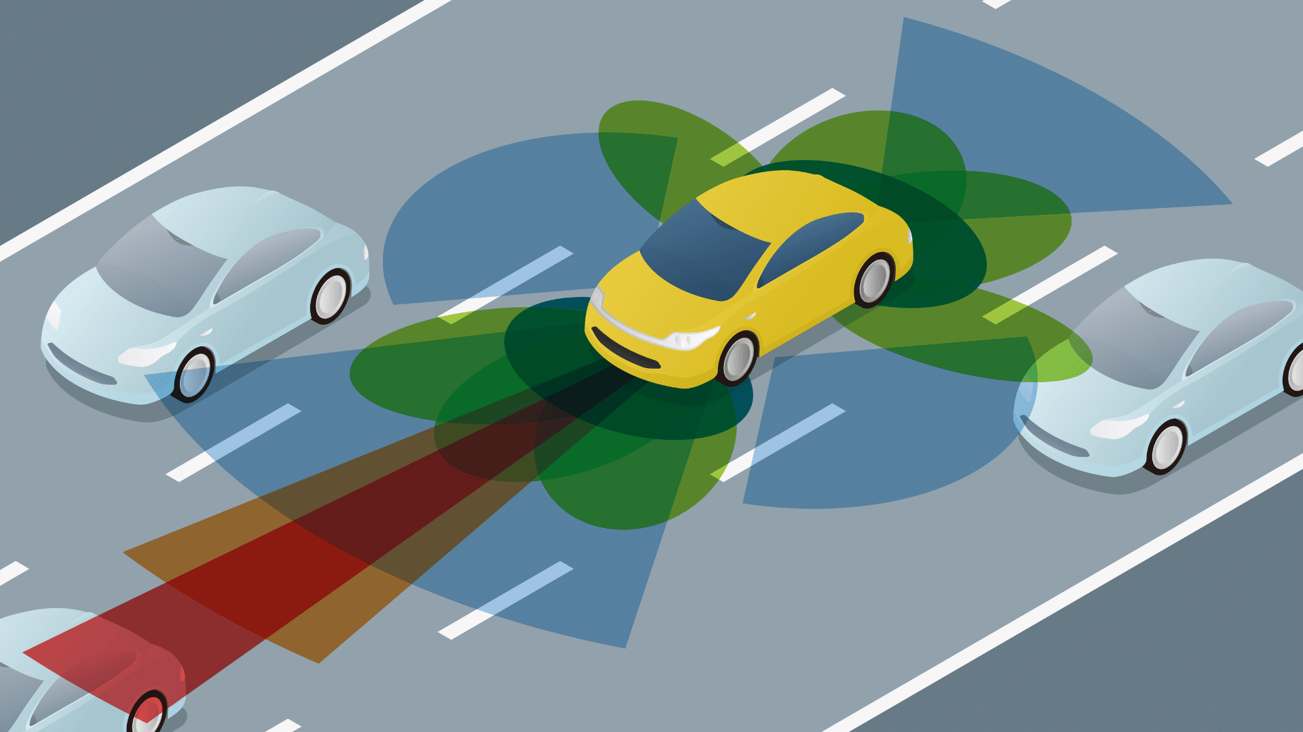
1. Problem Statement
Enhances Image Clarity:
Removes haze to restore details and improve overall image quality.
Supports Critical Applications:
Autonomous Vehicles:
Helps with obstacle detection and accurate navigation.
Surveillance Systems:
Enhances visibility for monitoring and identifying objects in adverse weather
conditions.
Satellite and Drone Imaging:
Improves image quality for environment-
tal monitoring, urban planning, and disaster assessment.

Slide 8
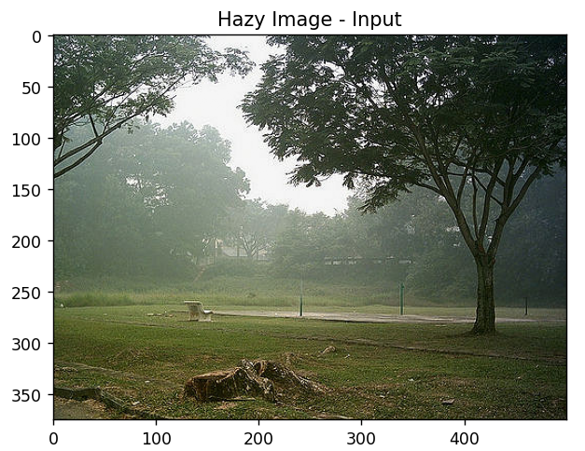
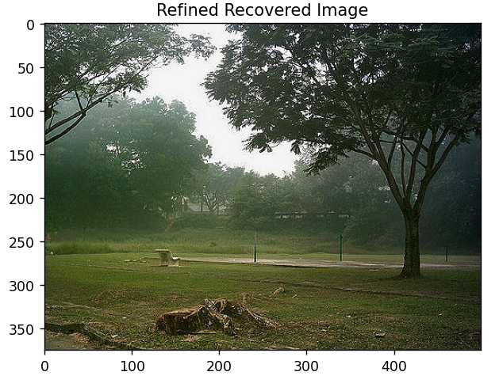
2. Input/ Output

Slide 9
Proposed Method

Slide 10
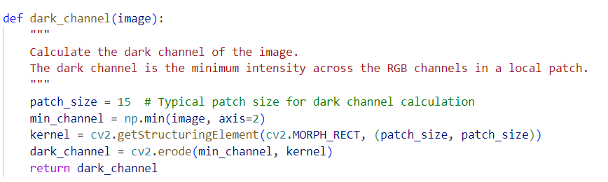
1. Proposed Method
Step1:
Compute Dark Channel to identify haze-affected areas.

Slide 11
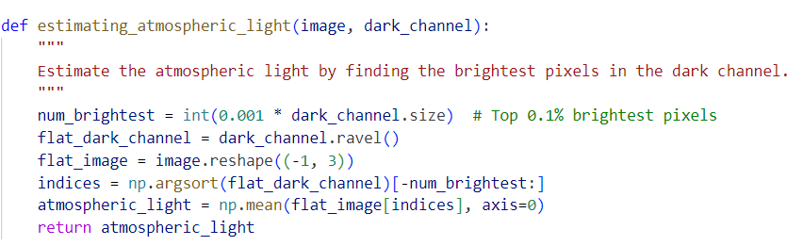
1. Proposed Method
Step 2:
Estimate atmospheric light using bright pixels.

Slide 12
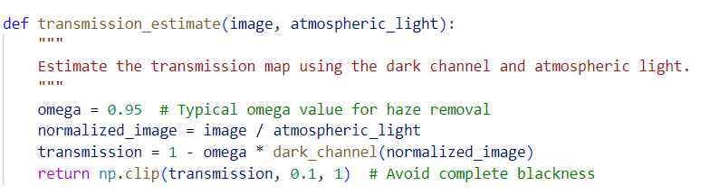
1. Proposed Method
Step 3:
Refine transmission map using Guided Image Filtering.

Slide 13
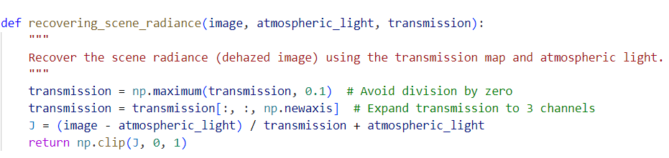
1. Proposed Method
Step 4:
Restore haze-free image with a radiance recovery formula.

Slide 14
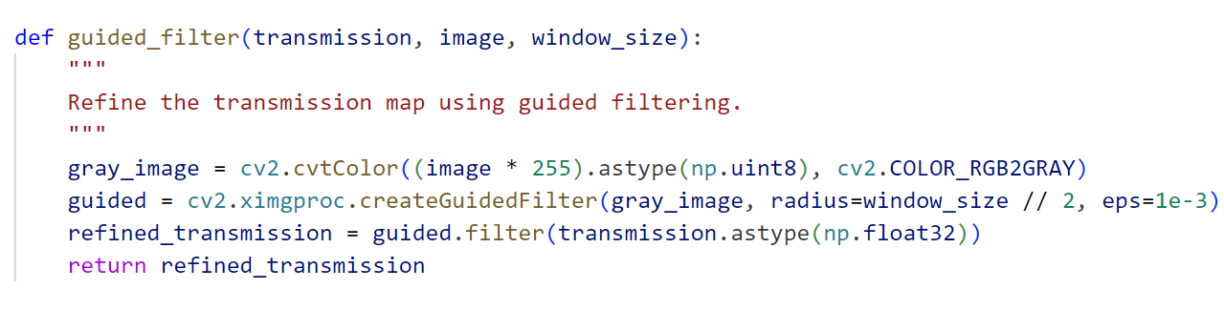
1. Proposed Method
Step 5:
Guided Image Filtering

Slide 15
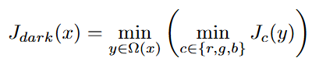
2. Algorithm Overview
Calculate Dark Channel:
Use a 15x15 patch to find minimum intensities
where Ω(x) is the local patch centered at pixel x

Slide 16
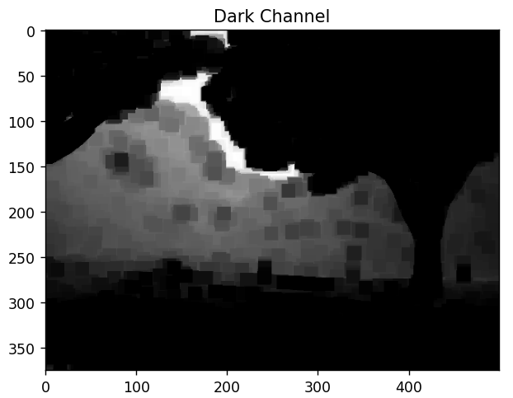
2. Algorithm Overview
Atmospheric Light Estimation:
Identify brightest dark channel pixels.

Slide 17
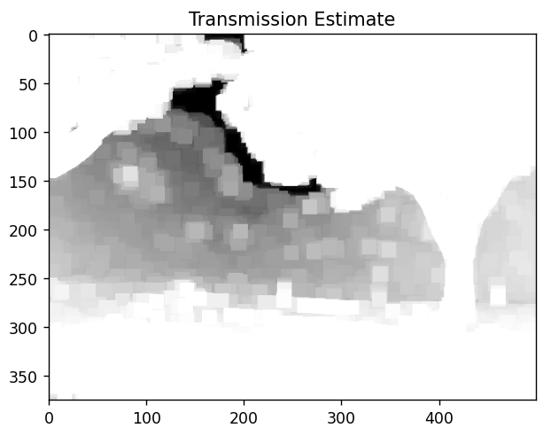
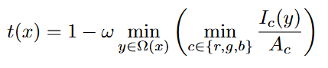
2. Algorithm Overview
Transmission Map Estimation:
Compute using normalized images.
ω : a parameter to preserve a certain degree of haze fordepth perception.

Slide 18
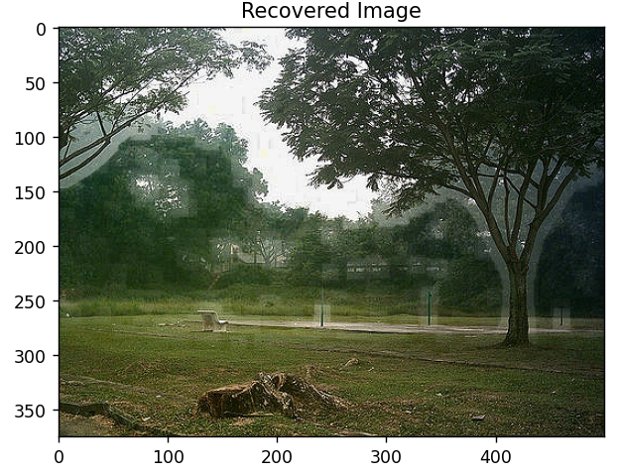
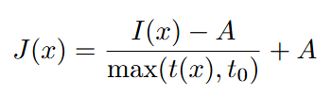
2. Algorithm Overview
Scene Radiance Recovery:
Restore image using transmission map and light.
where t0 is a lower bound to avoid division by zero.

Slide 19
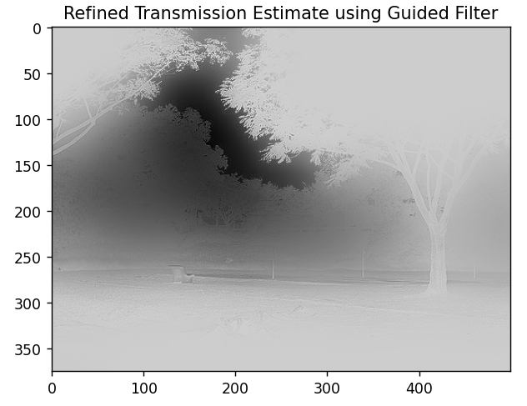
2. Algorithm Overview
Guided Image Filtering:
Smooth transmission map while preserving edges.

Slide 20
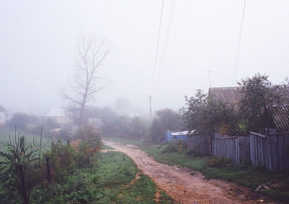
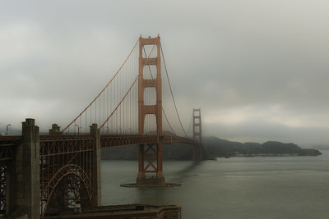
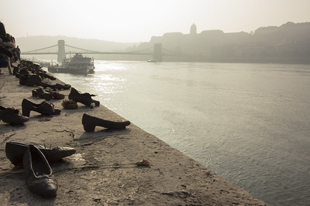
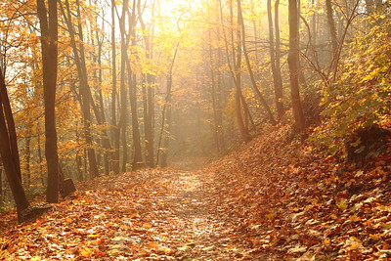
3.1 Experiment
Datasets:

Slide 21
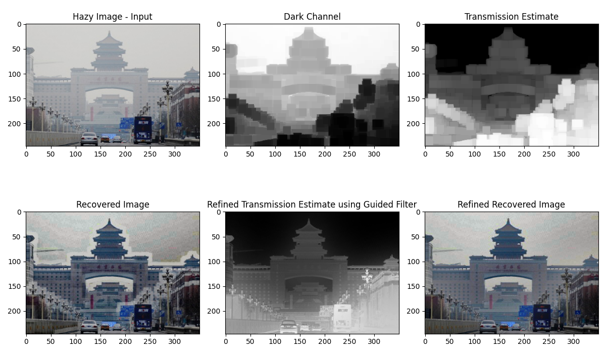
3.1 Experiment

Slide 22
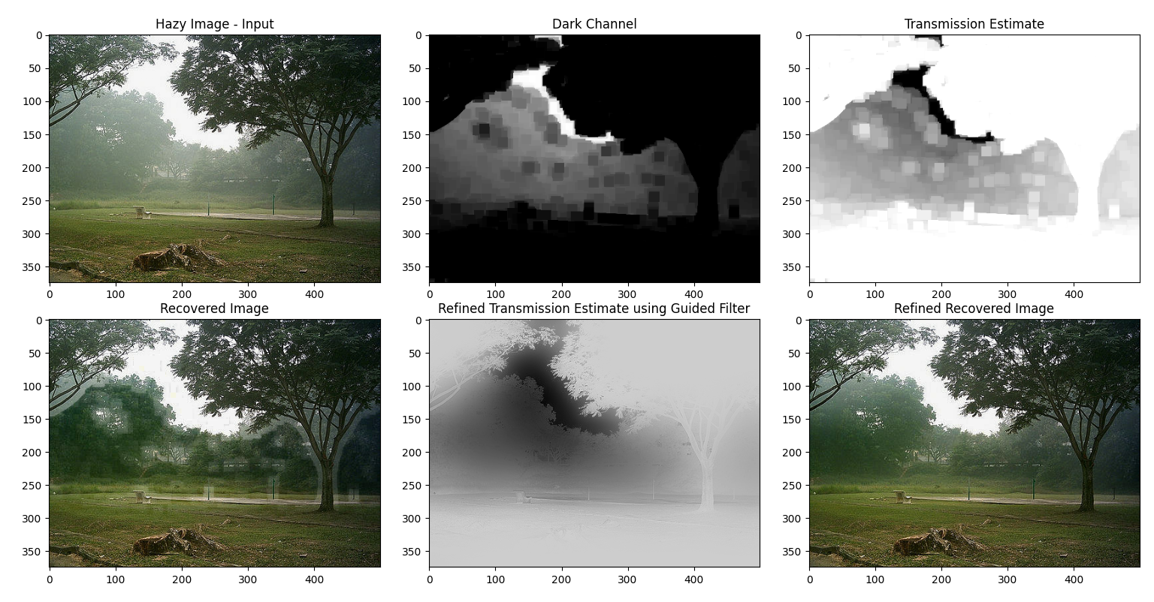
3.1 Experiment

Slide 23
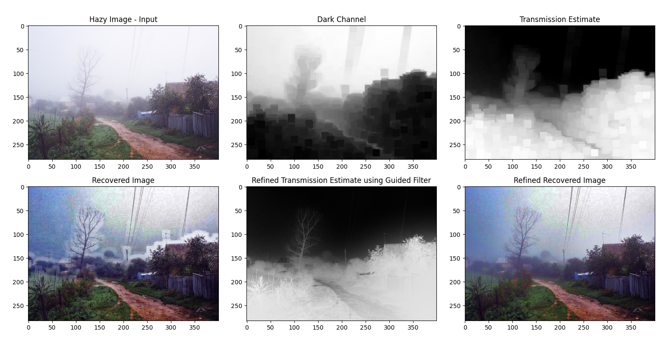
3.1 Experiment

Slide 24
3.1 Experiment
Experimental Results:
Significant visibility improvement.
Guided Image Filtering reduced artifacts.
Efficient for real-time applications.

Slide 25
3. Experiment
Discussion:
Effectiveness: The DCP method effectively removes haze and enhances image visibility. The use of Guided Image Filtering further improves the results by eliminating artifacts.
Performance: The method is computationally efficient, suitable for real-time applications. However, large images and high-resolution inputs may require optimization to reduce processing time.

Slide 26
3. Experiment
Conclusions
The DCP-based method successfully removeshaze from single images, enhancing visibility andclarity.
Refinement techniques such as Guided ImageFiltering are crucial for eliminating artifacts andachieving high-quality dehazed images.

Slide 27
3. Experiment
Future Works
Optimization: Further work is needed to optimize the algorithm for faster processing, especially for large images.
Handling Complex Scenes: Addressing challenges in scenes with white objects like snow or highly reflective surfaces.
Real-time Applications: Developing real-time implementations for video processing and surveillance systems

Slide 28
THANK YOU !

